Slide 1


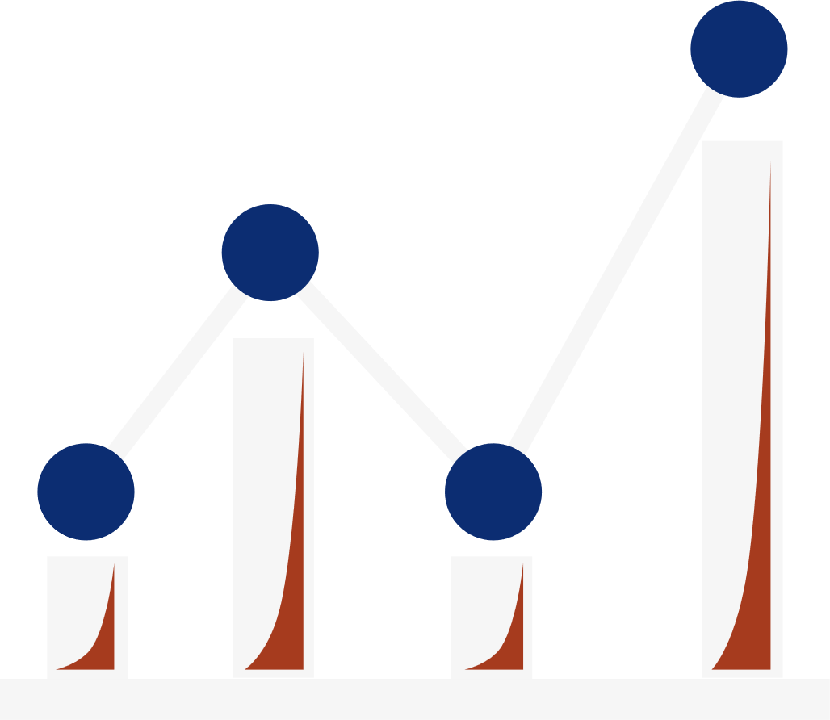

1
OPIM 5604 - Predictive Modelling
Bank Marketing Campaign
Group 3:
Sahibpreet Singh, Ruchika Jain, Ashima Gupta, Gowtham Janga, Himesh Raste
Team 3

Slide 2


2
Agenda
About the Dataset
Business Case
Knowing the Variables
Data Preprocessing
Building Models
Model Comparison
Evaluation
Conclusion
Deployment
Team 3

Slide 3




3
About the Dataset
The data is related to direct marketing campaigns of a Portuguese banking institution.
The marketing campaigns were based on phone calls.
Often, more than one contact to the same client was required, in order to access if the product (bank term deposit) would be subscribed or not.
Team 3

Slide 4


4
Business Case
PROBLEM :
The bank needs to get their target audience to subscribe to their Term Deposit which is a crucial source of income for the bank. They perform Digital, on-the-ground, and Telephonic campaigns to reach their audience with Telephonic Calling proven as the most effective so far. But, unfortunately reaching everyone on cell is very expensive for their campaigns as randomly calling customers requires a lot of investment in terms of resources, time, and money. Since the conversion rate is very low so there is a need to perform data analytics on the current datasets in order to target the eligible and interested audience only.
Team 3

Slide 5



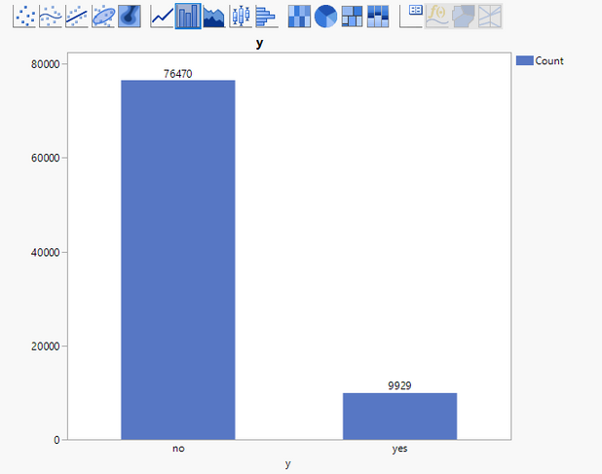
5
Term Deposit
Team 3

Slide 6


6
Business Case
VALUE :
Term deposits are a major source of income for a bank. It is a cash investment held at a financial institution.
The customer’s money is invested for an agreed rate of interest over a fixed amount of time, or term.
The more the people subscribe to the term deposit, the more the monetary benefit to the bank.
Performing Data Analytics would minimize the investment of the bank by narrowing the targeted population.
Team 3

Slide 7

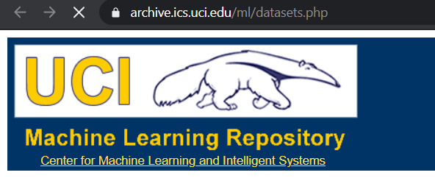
7
Knowing the Variables
4 DATASETS IN ZIP FOLDER
21 UNIQUE VARIABLES (PREDICTORS)
Y(TERM DEPOSIT) VARIABLE -> TARGET VARIABLE
45211 + 41187 + 4521 + 4118 ROWS
SOURCE: HTTPS://ARCHIVE.ICS.UCI.EDU/ML/DATASETS/BANK+MARKETING#
UCI MACHINE LEARNING REPOSITORY
Team 3

Slide 8



8
Predictors
# RELATED WITH THE LAST CONTACT OF THE CURRENT CAMPAIGN:
9 - contact: contact communication type
10- month: last contact month of the year (
11 - day_of_week and day: last contact day of the week
12 - duration: last contact duration, in seconds
13 - campaign: number of contacts performed during this campaign and for this client
14 - pdays: number of days that passed by after the client was last contacted from a previous campaign
15 - previous: number of contacts performed before this campaign and for this client
16 - poutcome: outcome of the previous marketing campaign
# BANK CLIENT DATA:
1 - age (numeric)
2 - job: type of job
3 - marital: marital status
4 - education: education level
5 - default: has credit in default?
6 - housing: has housing loan?
7 - balance: average yearly balance, in euros
8- loan: has a personal loan?
HISTORICAL BANKING DATA
DATA FROM PREVIOUS CAMPAIGN
# SOCIAL AND ECONOMIC CONTEXT ATTRIBUTES
17 - emp.var.rate: employment variation rate - quarterly indicator
18 - cons.price.idx: consumer price index - monthly indicator
19 - cons.conf.idx: consumer confidence index - monthly indicator
20 - euribor3m: euribor 3 month rate - daily indicator
21 - nr.employed: number of employees - quarterly indicator
Team 3
SOCIAL INDEXES

Slide 9

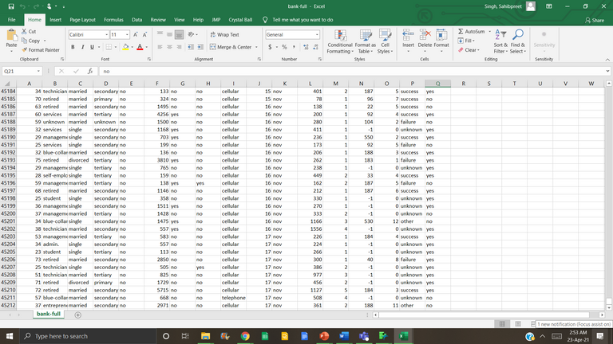
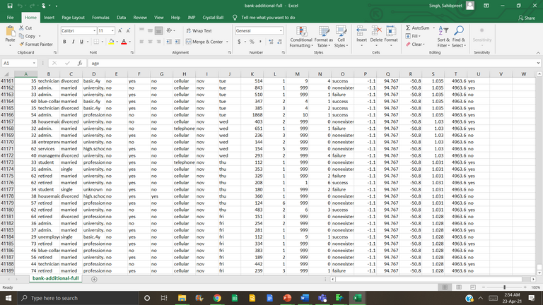

9
Data Preprocessing
Concatenated the two Datasets together in JMP by creating a unique ID column for both datasets.
01
41,187 ROWS
16 Predictors (1 Unique Predictor)
Team 3
20 Predictors (4 Unique Predictor)
TOTAL = 86,399 ROWS

Slide 10
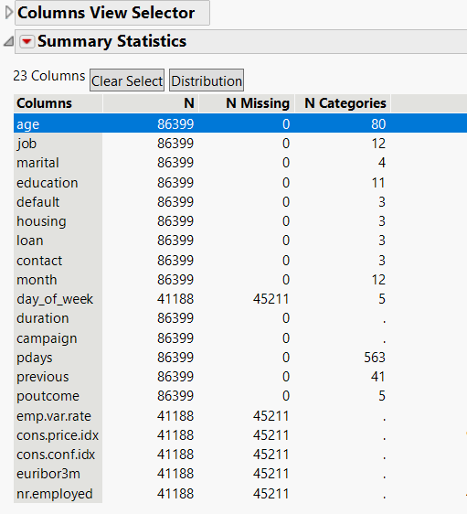
10
Data Preprocessing
02
Checked Missing Values
Originally there were no significant missing values in the individual datasets.
After merging the datasets, there were 5 unique variables that had missing values.
We decided to take the risk for the first iteration so, we kept and ran them in our model using the "Informative Missing" feature in JMP.
Team 3

Slide 11
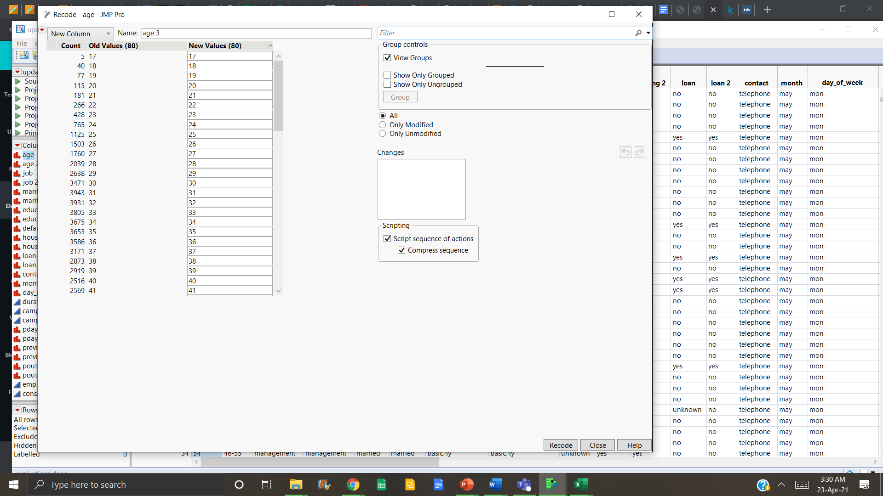
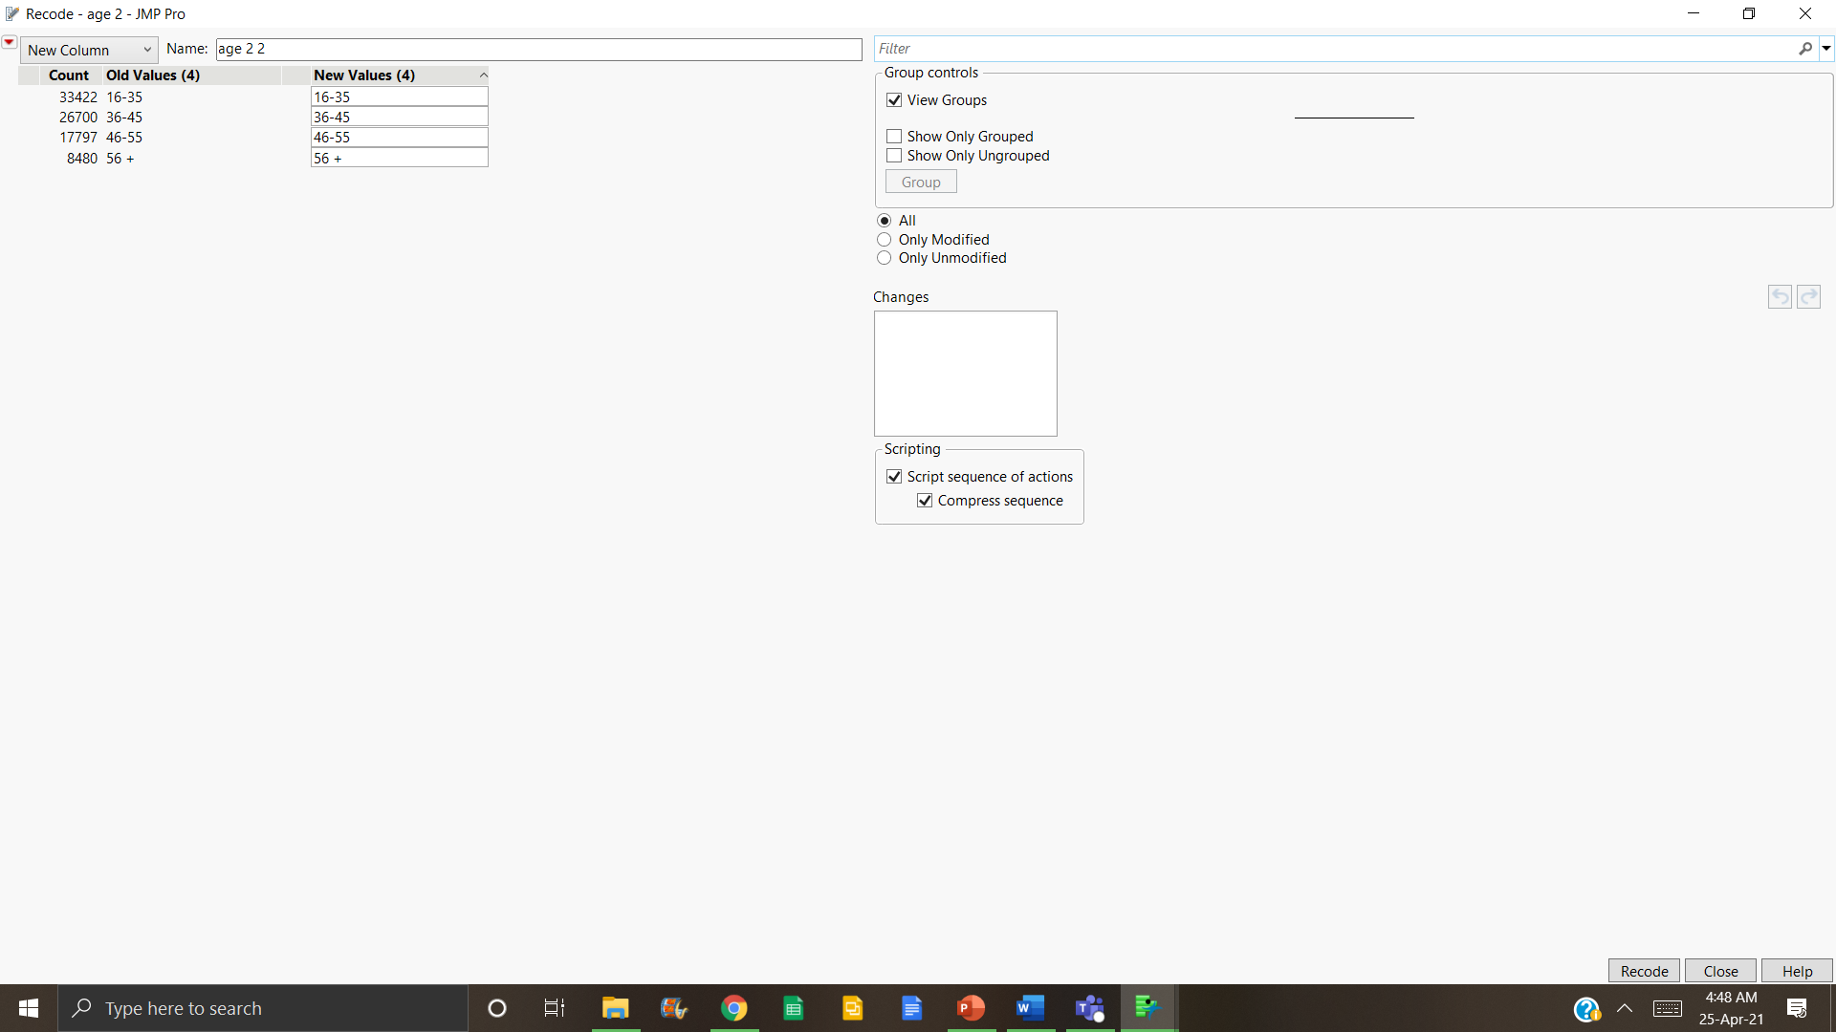

11
Data Preprocessing
03
Recoded the variables one by one
AGE
There were multiple values of age in continuous form, so we decided to convert the variable into categorical type by dividing age into 4 categories:-
16-35
36-45
46-55
56+
Team 3

Slide 12
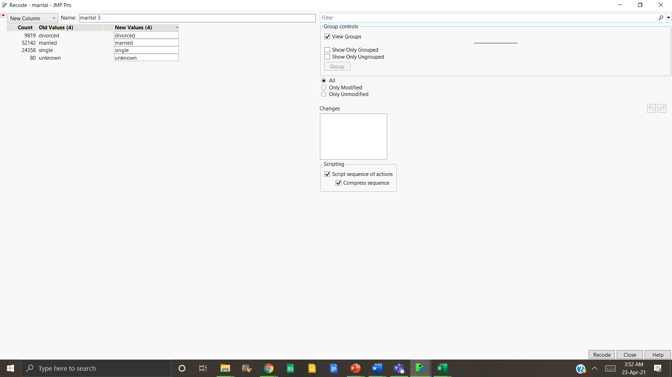
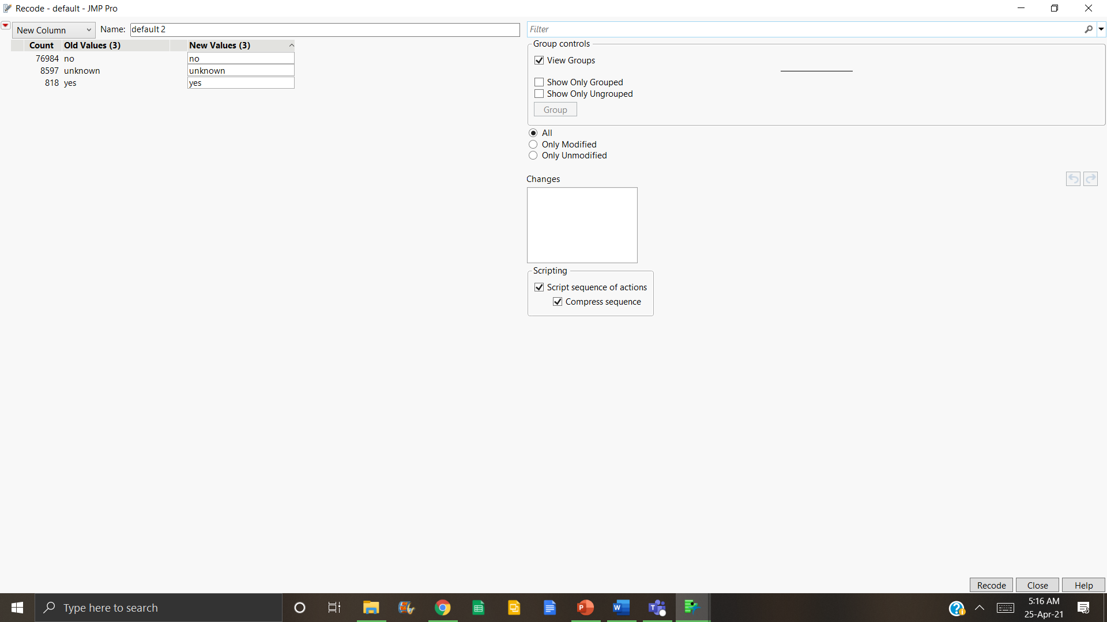
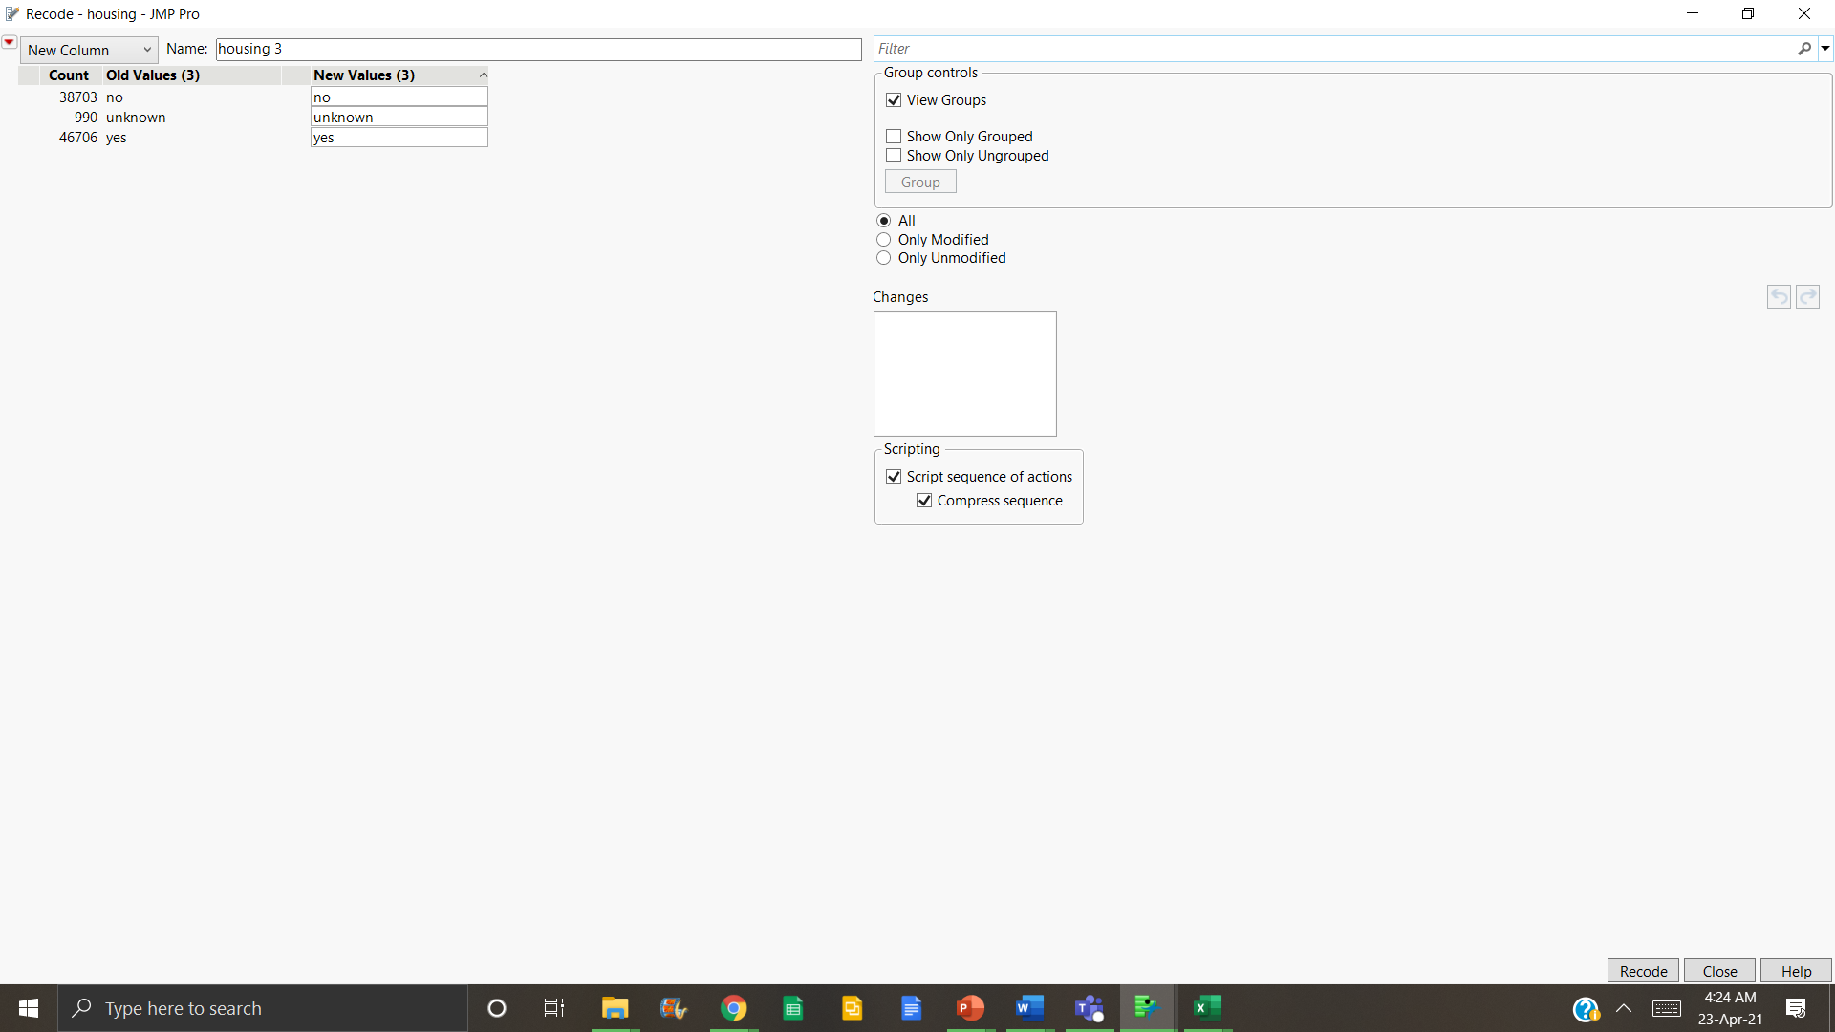
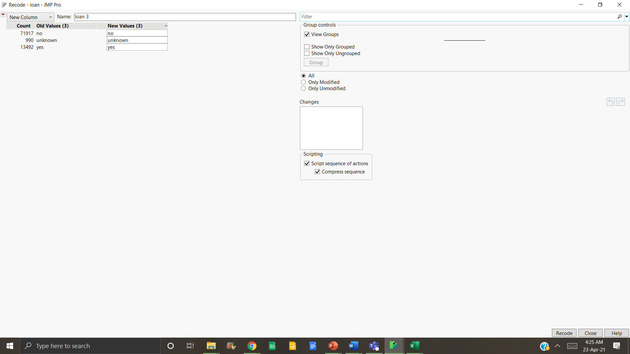
12
Data Preprocessing
MARITAL, DEFAULT, HOUSING AND LOAN
All these variables had an extra UNKNOWN category with the least values. Repeating a similar process as we did in previous slides and combining them with the highest value category.
Team 3

Slide 13
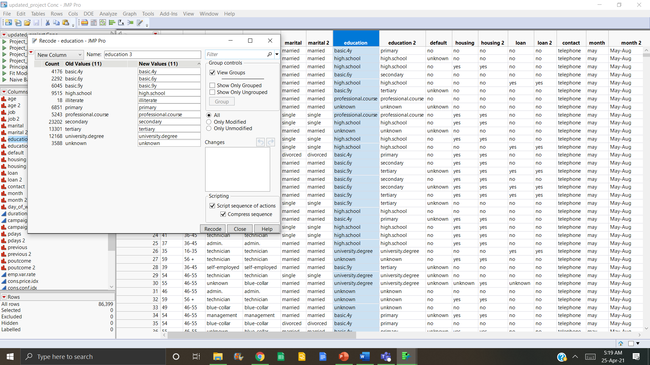

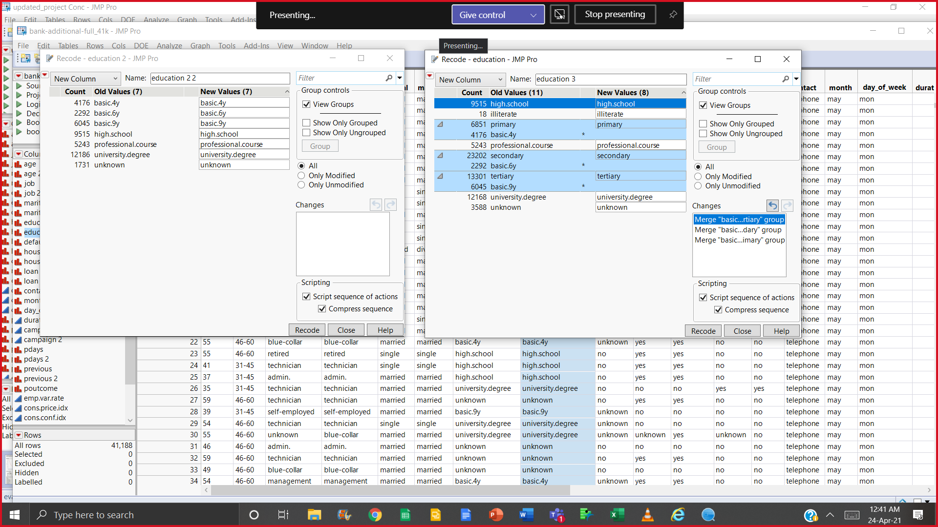
13
Data Preprocessing
EDUCATION
After merging two different datasets, we had redundant values in education. So we merged them in the following manner:
basic.4y + primary
basic.6y + secondary
basic.9y + tertiary
We kept unknown because it had significant values
Team 3

Slide 14
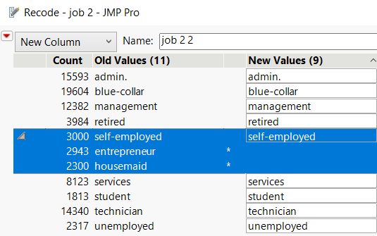
14
Data Preprocessing
JOB
We merged self-employed, entrepreneurs, and housemaids together due to their similar fields and lesser count.
After merging, the count is significant as compared to others.
Unknown had the least value of 618 with little or no significance so we decided to group it with the category that had the highest values i.e., blue-collar type job.
Team 3

Slide 15
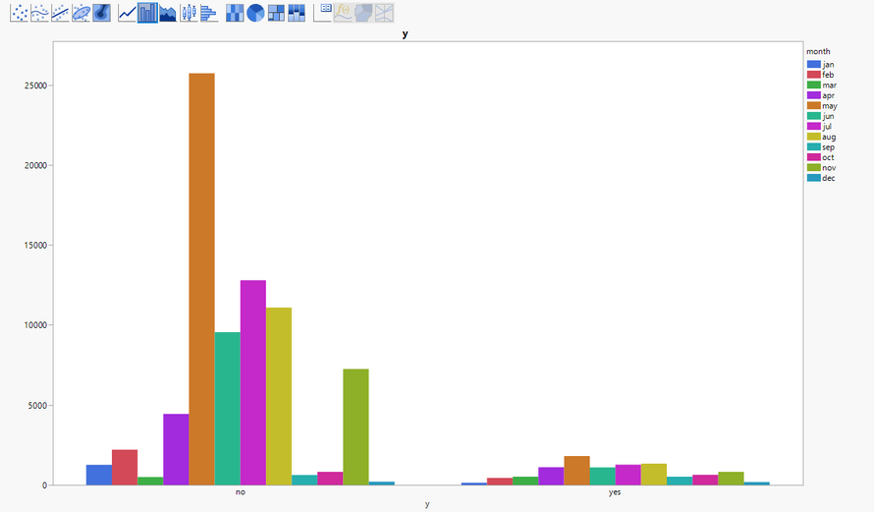
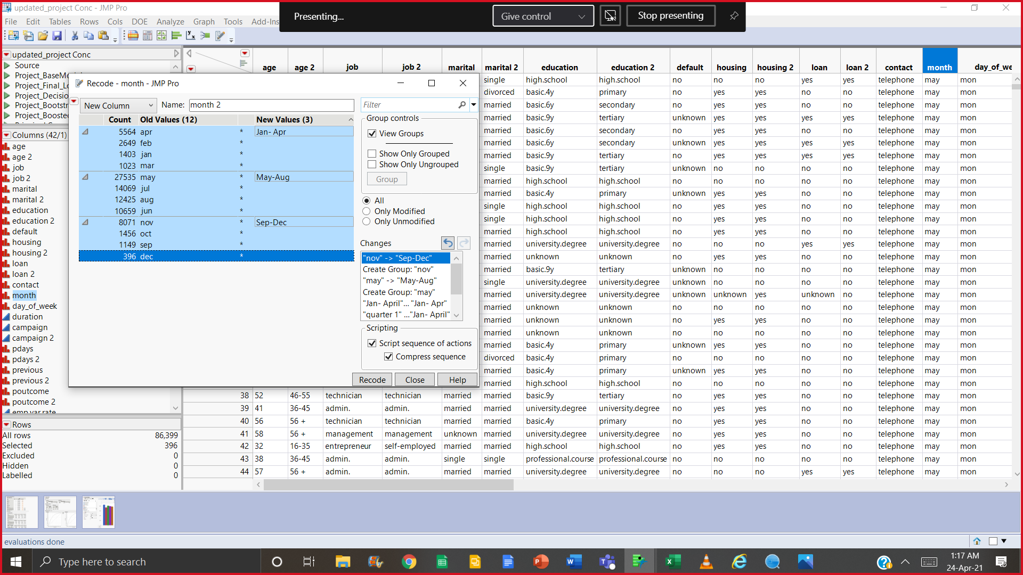
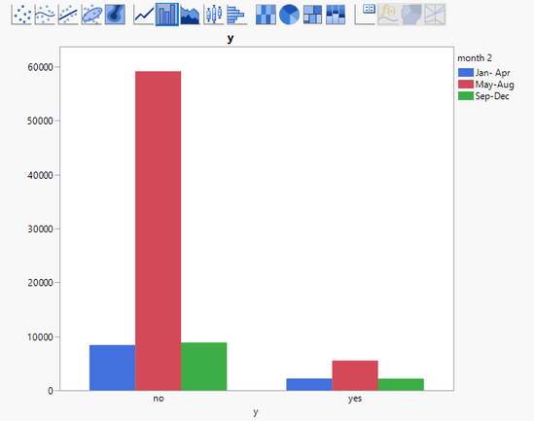
15
Data Preprocessing
MONTH
We tested to convert variable based on its distribution to fewer categories but while running in the model, the original variable provided better AUC and greater significance in the model.
So, we decided to keep this variable in the model
Team 3

Slide 16
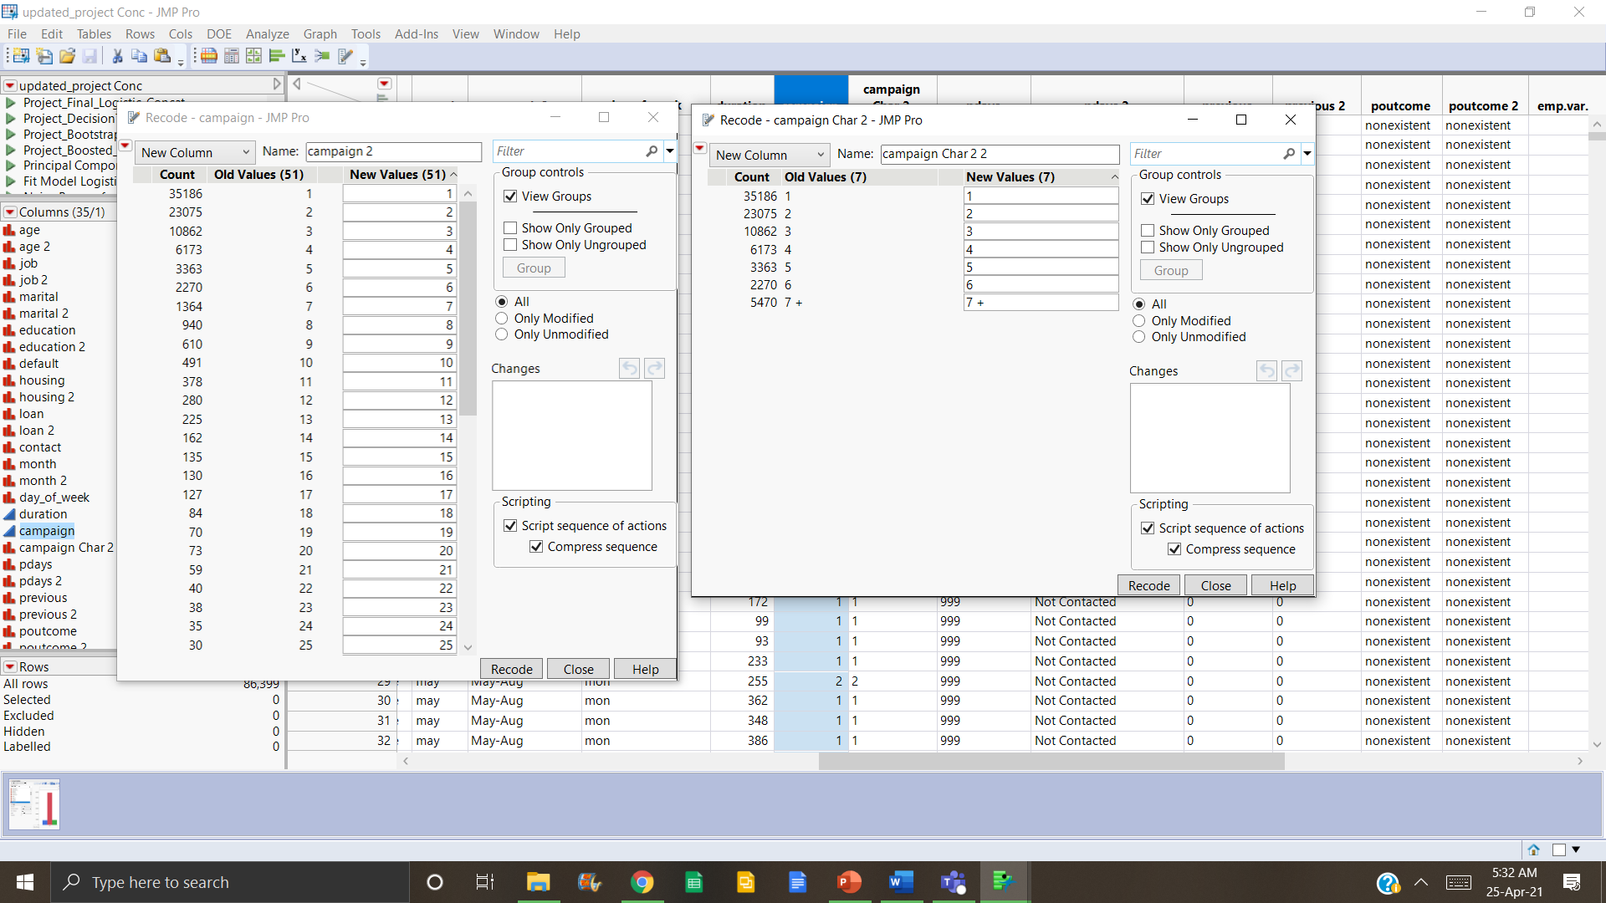
16
Data Preprocessing
CAMPAIGN
Based on its irregular distribution, we converted the campaign into a categorical variable with a comparatively better distribution while merging 7 and above values together.
We ran models with both variables
Team 3

Slide 17
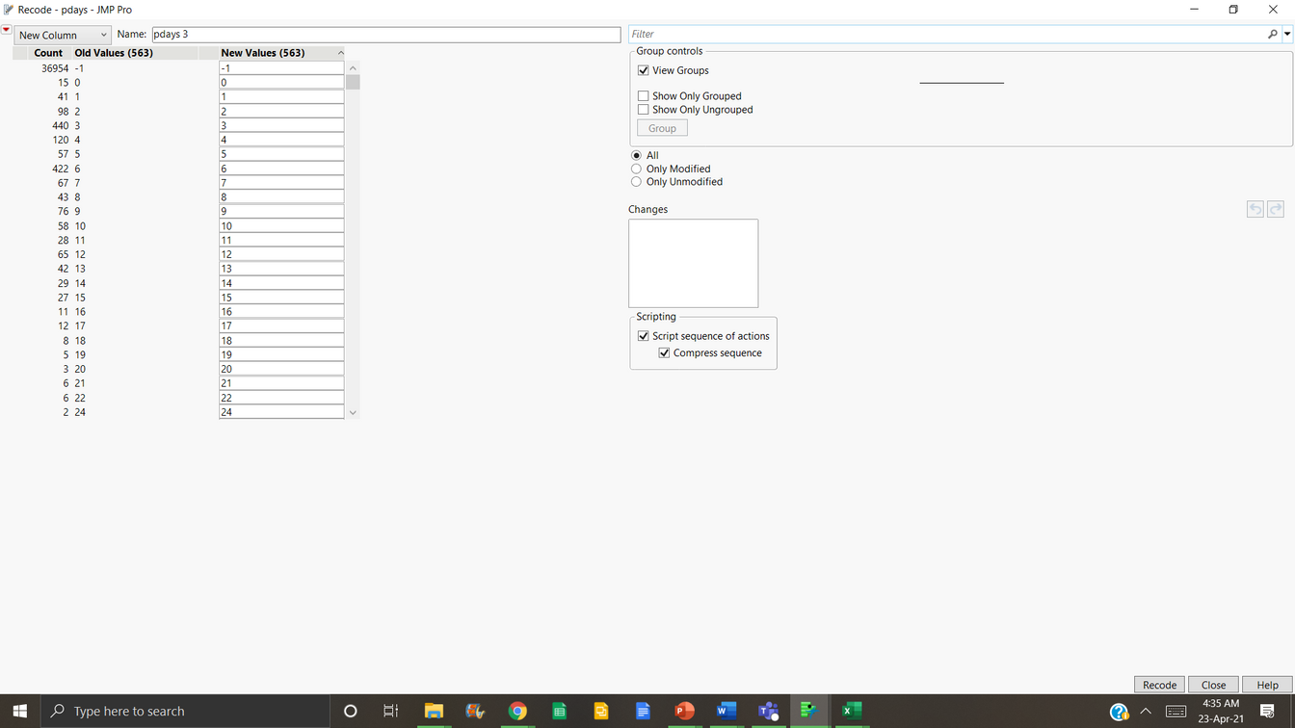
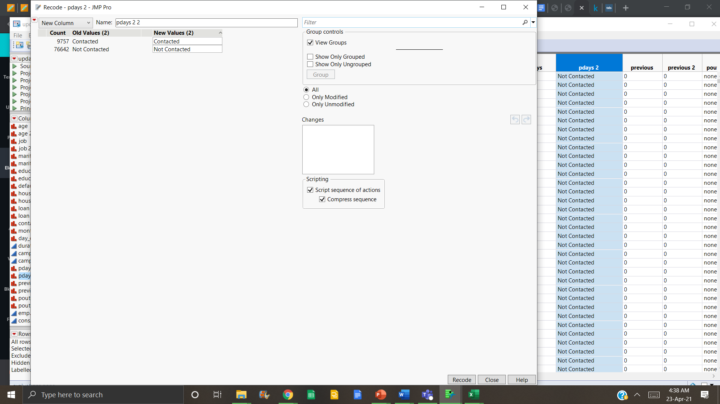
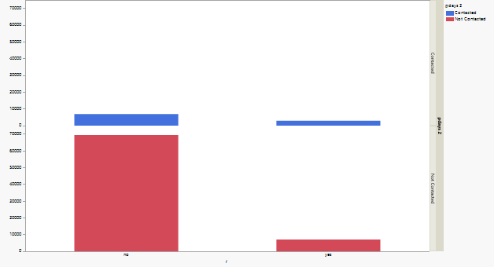
17
Data Preprocessing
PDAYS
The values were significantly lesser for days contacted and had a higher value if the lead wasn't contacted.
We decided to keep this variable but after converting it into a categorical variable with categories contacted and not contacted to observe its effect.
Team 3

Slide 18
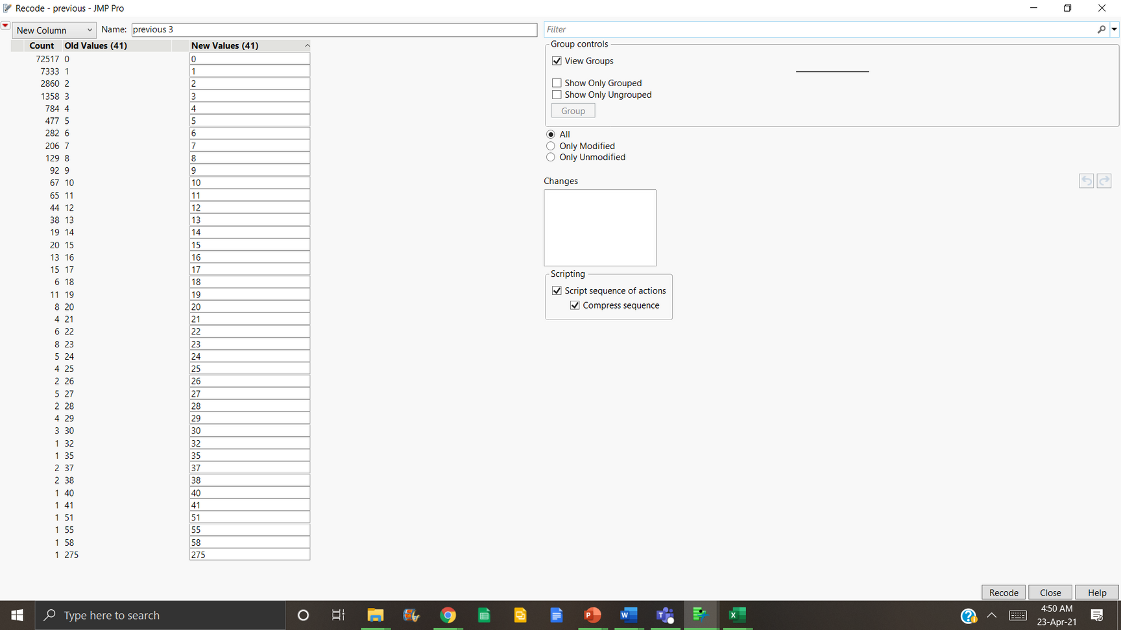
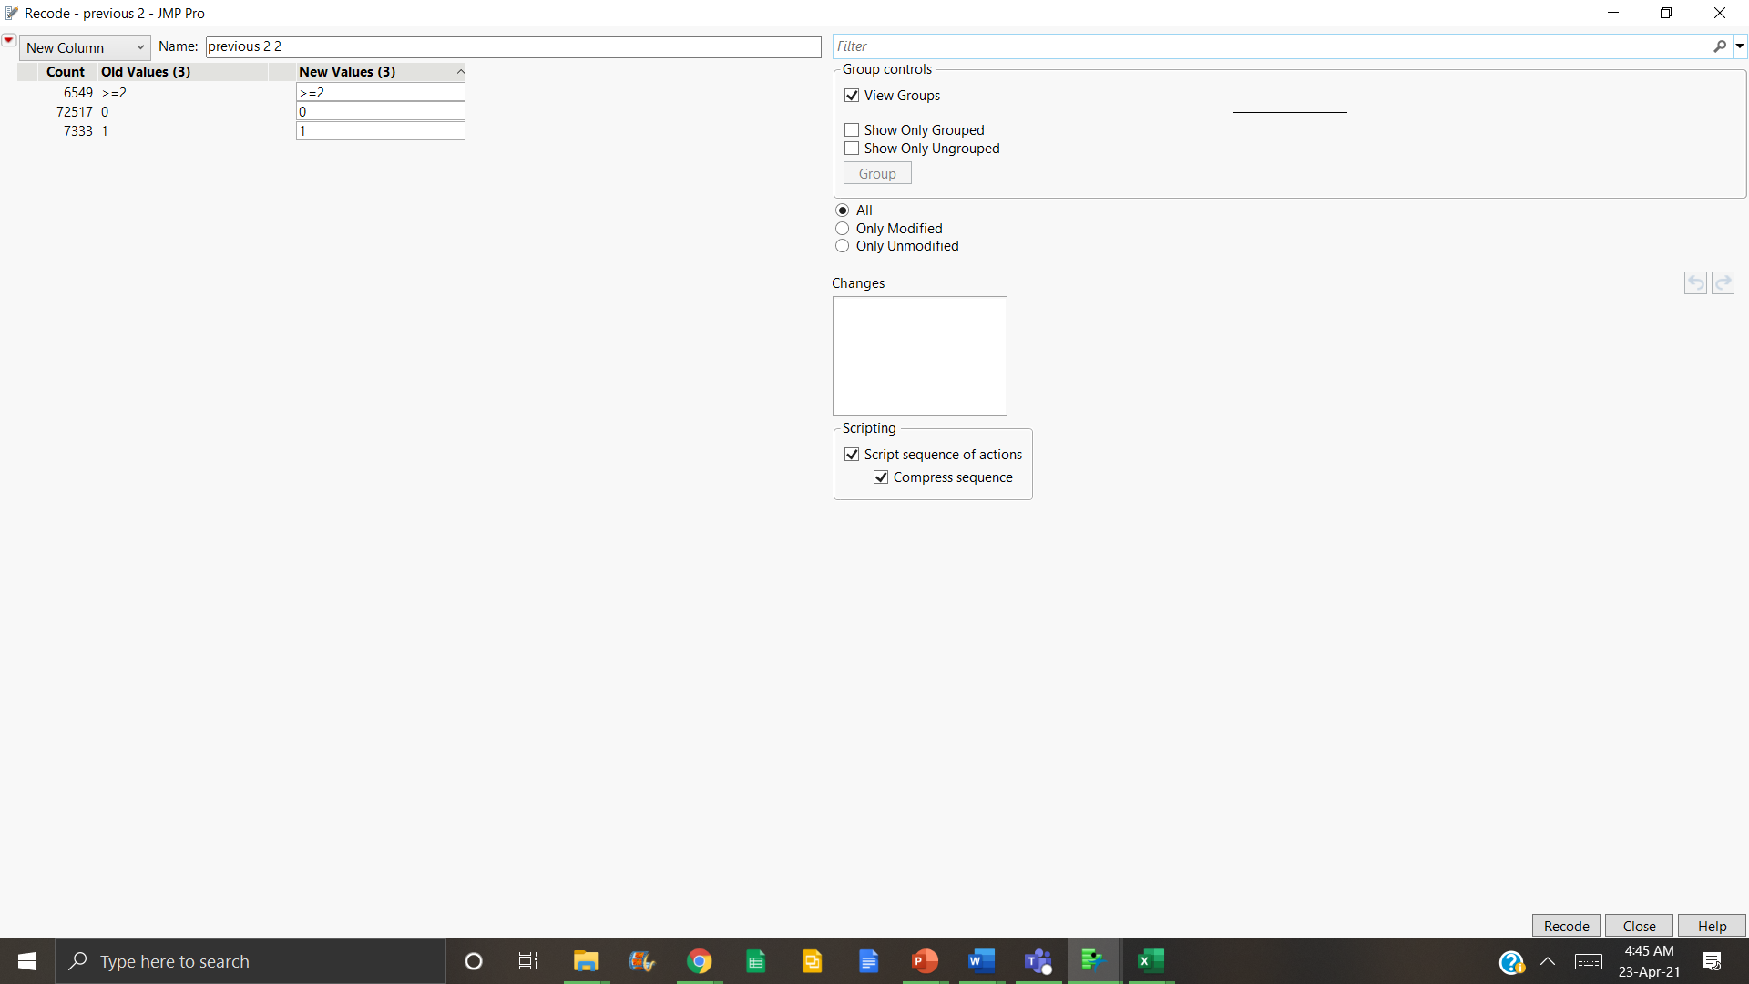
18
Data Preprocessing
PREVIOUS
Similarly to the last variable (pdays), values were very less so we recoded to convert it into 3 categories.
Team 3

Slide 19
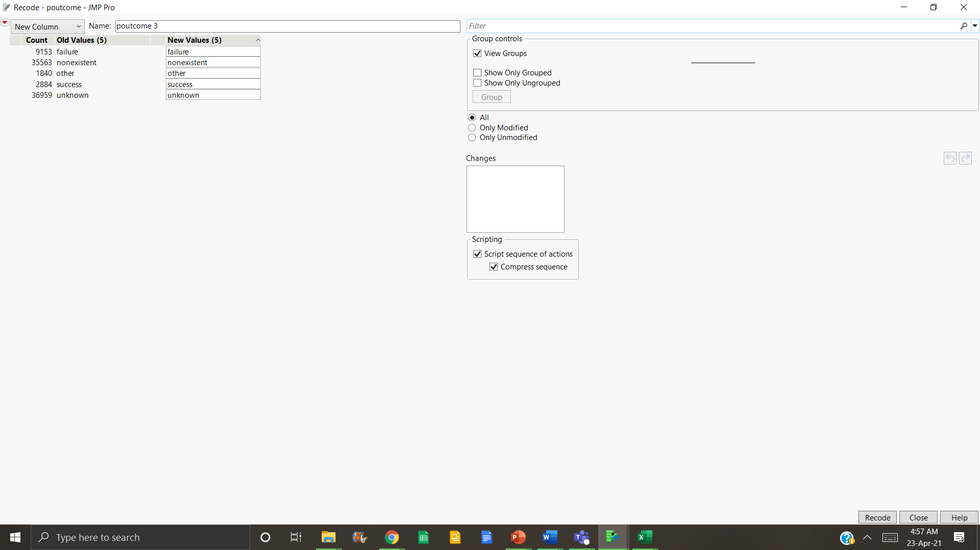
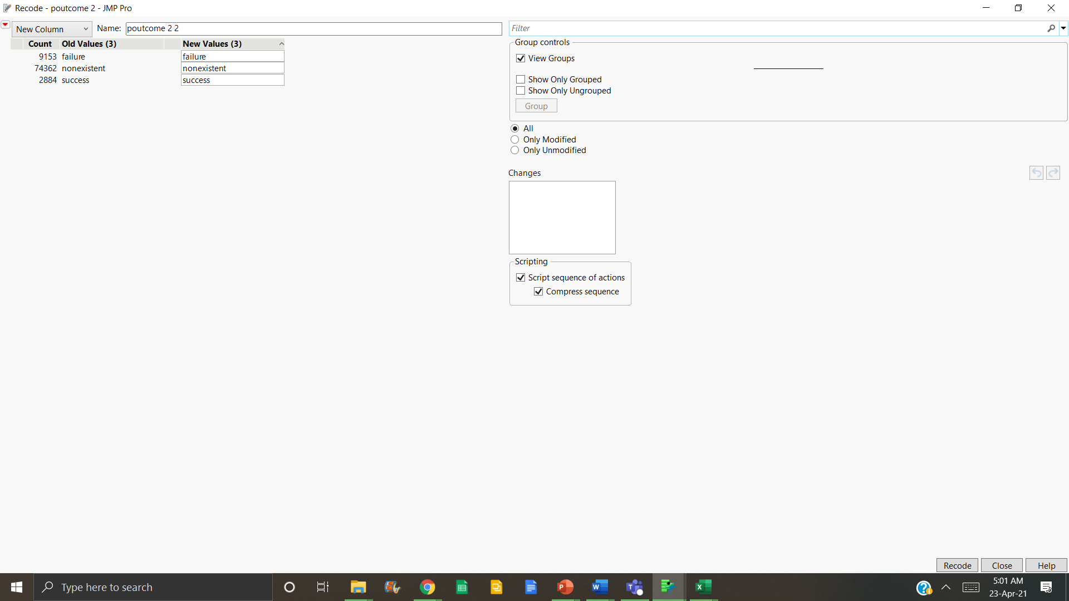
19
Data Preprocessing
POUTCOME
Since Poutcome had vague 5 categories, so we decided to combine 3 of them into 1 since it reflected the same output. So we recoded to get 3 categories of Failure, Success, and Nonexistent
Team 3

Slide 20
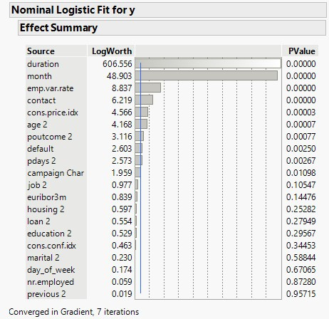
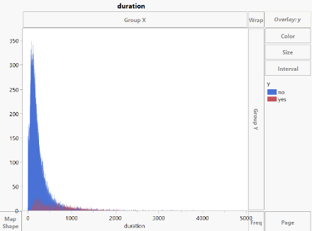
20
Running Models
"Duration" A Target Leakage?
Duration of call (in Seconds)
Duration is unknown before performing the call.
Keeping it in the baseline model, it gives the highest log worth.
It could be observed when the duration exceeds a certain point, most customers say “Yes” to the “Term Deposit”.
Therefore, we decided to remove the variable as it is a target leakage.
Team 3

Slide 21

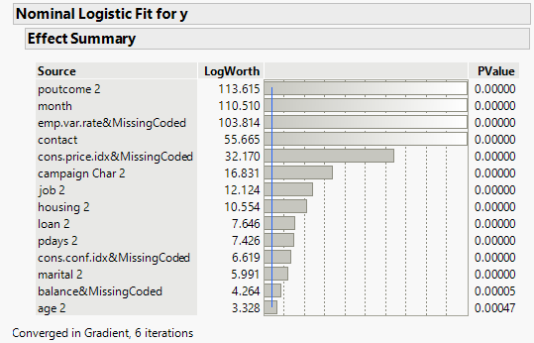
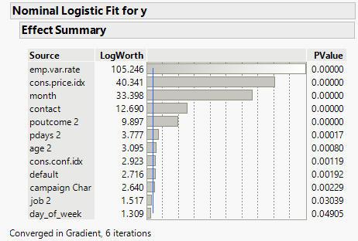


21
FINAL LOGISTIC MODEL WITH 86K ROWS
FINAL LOGISTIC MODEL WITH 41K ROWS
(Concatenated Dataset)
(Subset and Updated Version)
Best Predictors: poutcome, month, emp.var.rate and contact
AUC: 0.7799
Precision: 0.68
Recall: 0.164
Accuracy: 0.89
High Missing Values
Best Predictors: emp.var.rate, cons.price.idx, month and contact
AUC: 0.7992
Precision: 0.65
Recall: 0.24
Accuracy: 0.896
Low Missing Values
Team 3

Slide 22
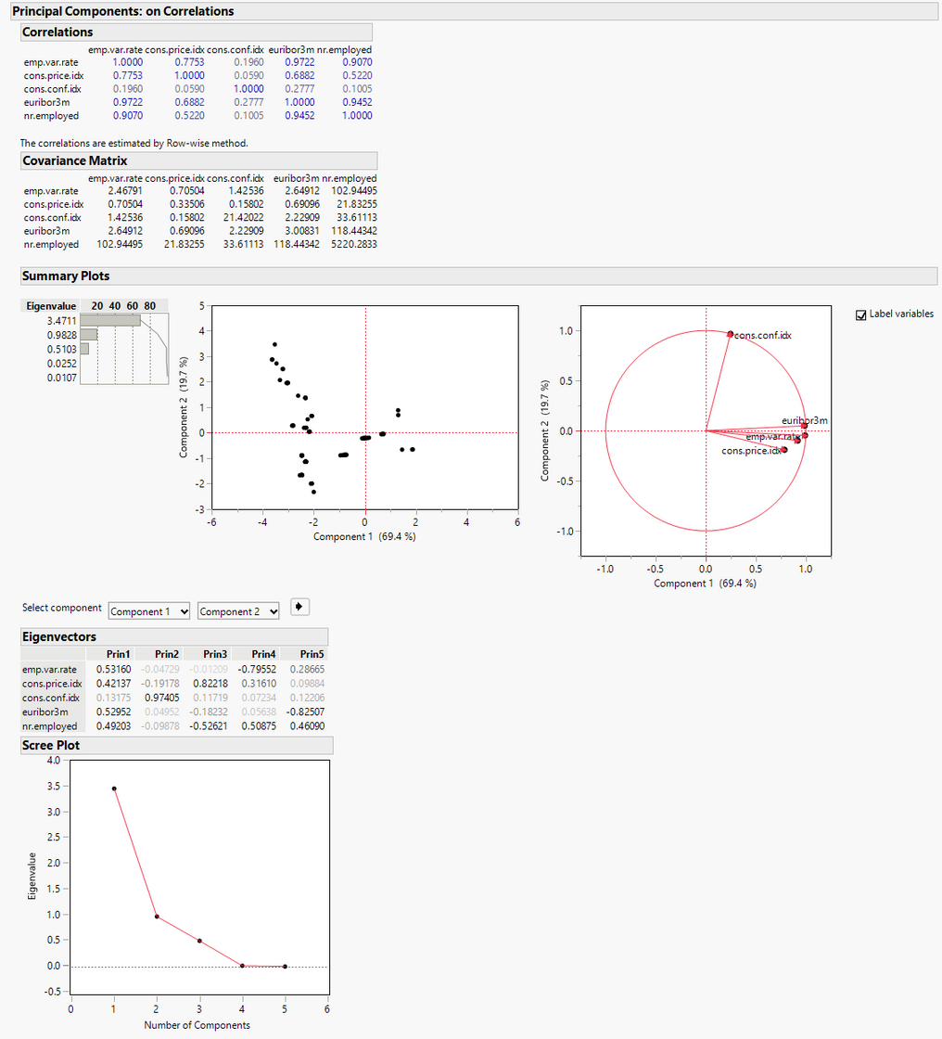

22
Correlation and Creating
PCA Elements
5 Elements with different behavior observed
Applying PCA on emp.var, cons.price, cons.conf, Euribor, and nr.employed
Variation captured with 3 new PCA Elements.
Used the new elements in the model Prin1, Prin2 and Prin3
Team 3

Slide 23
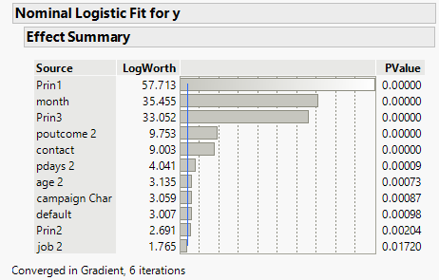
23
LOGISTIC MODEL WITH NON PCA ELEMENTS
LOGISTIC MODEL WITH PCA ELEMENTS
(Subset and Updated Version)
(Subset and Updated Version)
Best Predictors: emp.var.rate, cons.price.idx, month and contact
AUC: 0.7992
Better Transparency
Best Predictors: Prin1, month, Prin 3, poutcome 2
AUC: 0.7958
Lesser Transparency
Team 3

Slide 24
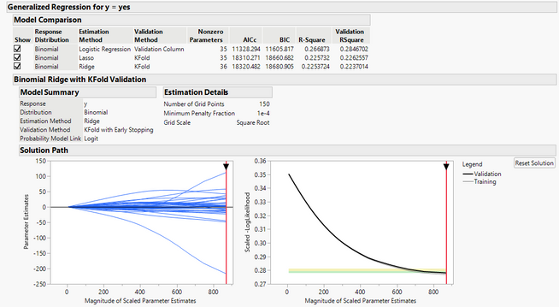
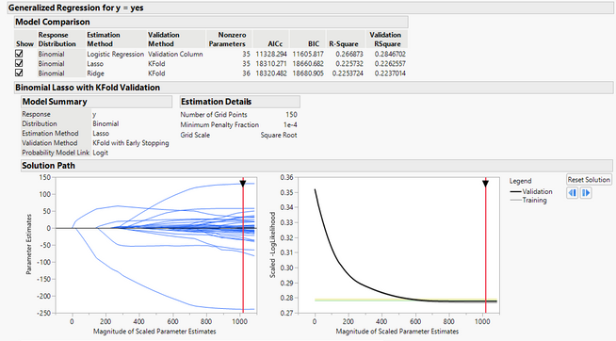
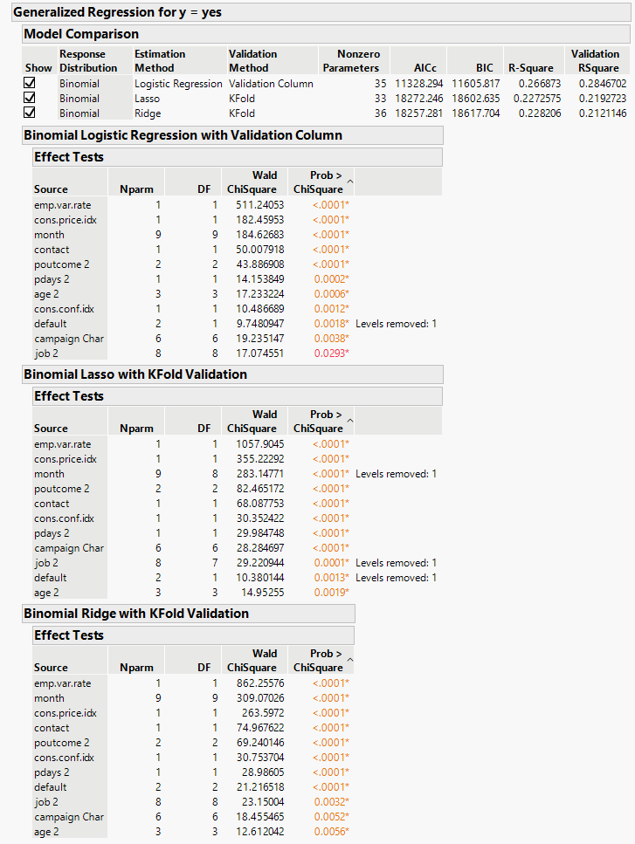
24
RIDGE
LASSO
Best Predictors: emp.var.rate, month, contact and cons.price.idx
AUC: 0.7870
Precision: 0.65
Recall: 0.19
Accuracy: 0.8977
Best Predictors: emp.var.rate, cons.price.idx, month and contact
AUC: 0.7890
Precision: 0.63
Recall: 0.21
Accuracy: 0.8974
Team 3

Slide 25
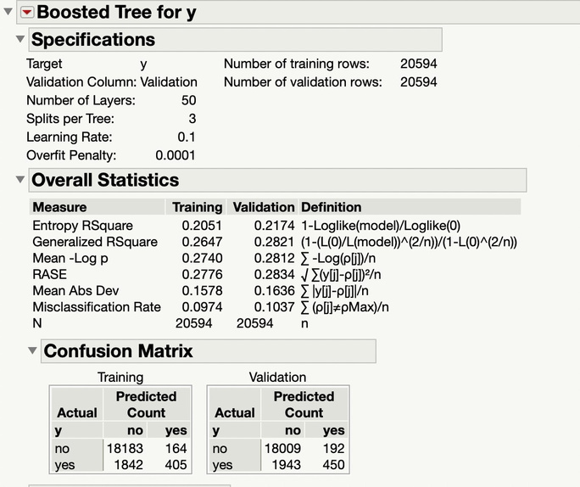
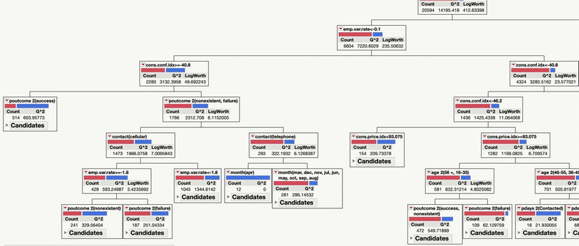
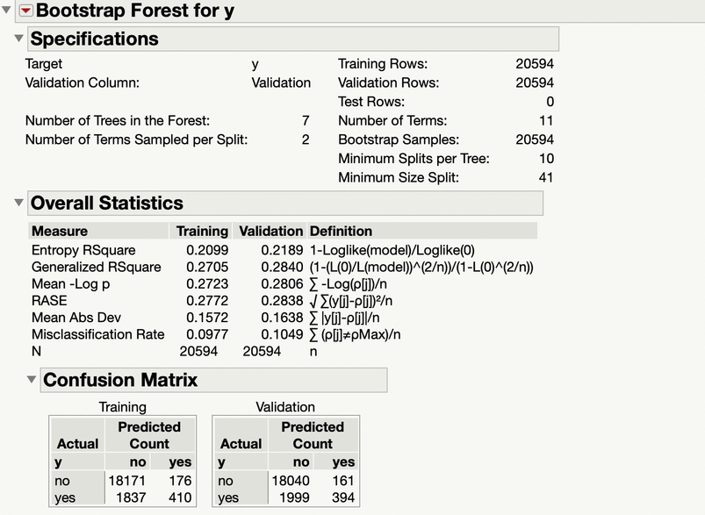

25
AUC: 0.7945
AUC: 0.8008
DECISION TREE
BOOSTED TREE
BOOTSTRAP FOREST
AUC: 0.8009
Accuracy: 0.8966
Precision: 0.7143
Recall: 0.1839
Team 3

Slide 26
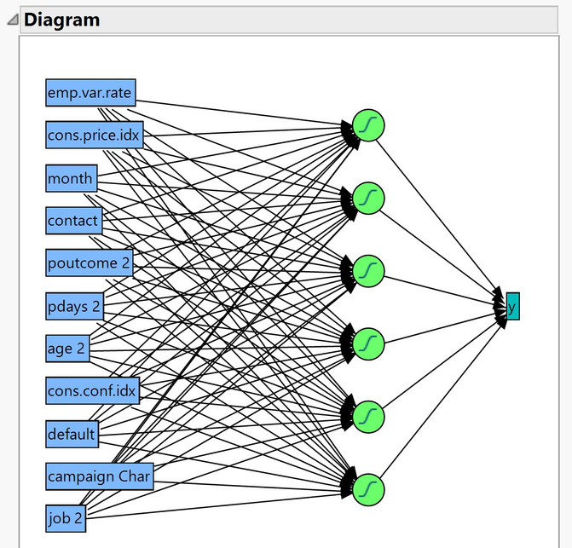
26
TanH(3) – 5 seconds -AUC : 0.7992
TanH(3)TanH2(3) – 9 seconds -AUC : 0.7977
TanH(6) – 10 seconds -AUC : 0.8023
TanH(3)Linear(3)Gaussian(3) TanH2(3)Linear2(3)Gaussian2(3) – 10 seconds -AUC : 0.7911
TanH(3)Linear(3)Gaussian(3) – 8 seconds -AUC : 0.7961
TanH(3)Linear(3)TanH2(3)Linear2(3) – 15 seconds -AUC : 0.7930
TanH(2)Linear(2)Gaussian(2) TanH2(2)Linear2(2)Gaussian2(2) – 12 seconds-AUC :0. 8015
Neural Networks
AUC: 0.8023
Layers: TanH(6)
Accuracy: 0.8953
Precision: 0.6292
Recall: 0.2411
. The best neural network is with 1 hidden layer with TanH(6) .
Team 3

Slide 27
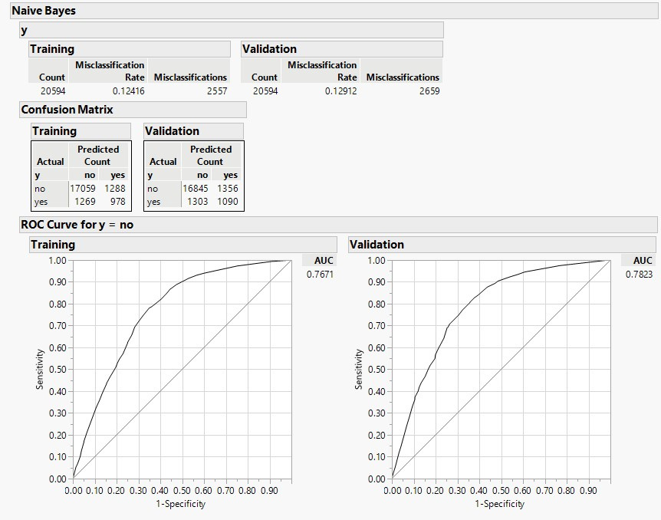
27
Naive Bayes
AUC: 0.7823
Accuracy: 0.87
Precision: 0.445
Recall: 0.455
Team 3

Slide 28
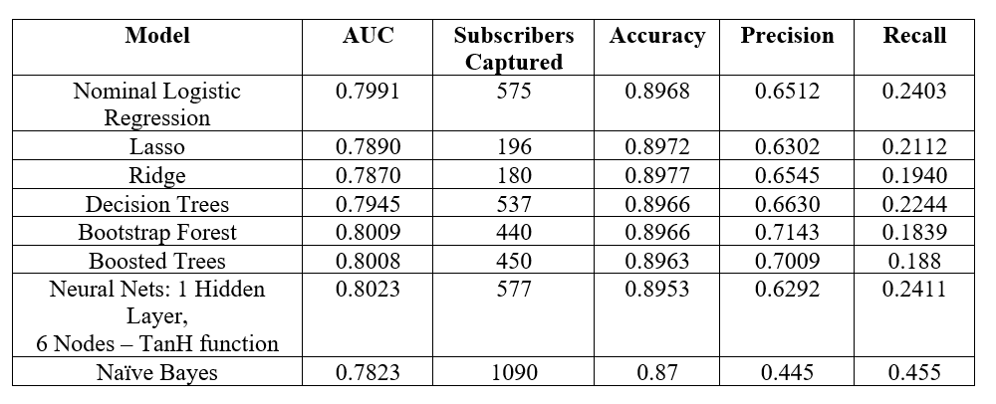
28
How the models translate
Team 3

Slide 29


29
Evaluation
"Employment Variation Rate" and "Consumer Price Index" are important factors for determining the success of the campaign. It tells the important economic and social status of the targeted lead.
A stable employment rate denotes a stable economic environment.
An increase in CPI increases the subscription.
"Month" is an important factor determining the success of the campaign as it indicates the months with the highest conversion rate probability.
Clients with cellular contact are most likely to subscribe to the term deposit as compared to telephone contact. The Comfort level of the leads is more on a cellphone.
Poutcome: It is a categorical variable that specifies the outcome of the previous marketing campaign (‘failure’, ‘nonexistent’, ‘success’). People with the response of "Yes" in the previous campaign are the most likely audience for subscribing to the term deposit.
Team 3

Slide 30

30
Conclusion
Our dataset has Class Imbalance
AUC was not the most appropriate metric for model comparison.
We considered Recall as the measure for choosing models.
In our business case, the most important factor is FN that is False-negative which means we predicted it as “No” but actually it was “Yes”. The metric which deals with it is Recall and hence recall is the most significant metric to be considered for our model.
Used Naive Bayes as the final model with Recall= 0.455
When we ran penalized regression(Lasso and Ridge), there was insignificant conversion to zero which shows very less correlation of the variables.
This was evident in the Naive Model because it uses the independent probability of the variables.
The independence assumption tends to make the probability estimates more extreme in the correct direction.
Team 3

Slide 31

31
01
02
LOGISTIC REGRESSION
LASSO PENALISED REGRESSION
Models Comparison
Best Predictors: emp.var.rate, cons.price.idx, month and contact
AUC: 0.7992
Accuracy: 0.896
Precision: 0.65
Recall: 0.24
Best Predictors: emp.var.rate, cons.price.idx, month and contact
AUC: 0.7890
Accuracy: 0.8972
Precision: 0.6302
Recall: 0.2112
03
04
05
NEURAL NETWORK TANH(6)
NAIVE BAYES
BOOTSTRAP FOREST
AUC: 0.8009
Accuracy: 0.8966
Precision: 0.7143
Recall: 0.1839
AUC: 0.8023
Layers: TanH(6)
Accuracy: 0.8953
Precision: 0.6292
Recall: 0.2411
AUC: 0.7823
Accuracy: 0.87
Precision: 0.445
Recall: 0.455
Team 3

Slide 32

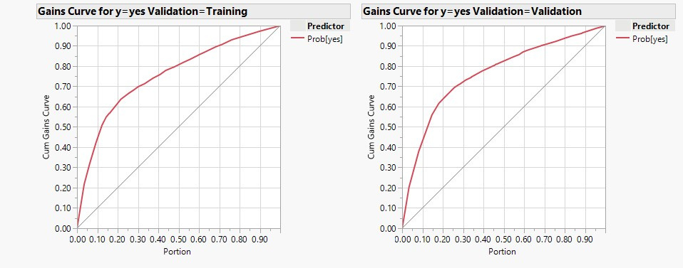

32
Solving the Business Problem
USING THE NAIVE BAYES MODEL
While observing the Validation “Yes” gain curve it can be seen that we captured 62% of the customers saying “Yes” while observing only 20% of the overall database.
Team 3

Slide 33

33
Deployment
Performing data analytics is the most important part of any industry with rising competition. Marketing analytics campaigns are used by the majority of business organizations. Our model can be used in the real world to help the bank get their targeted customers with minimum investment and get the maximum conversion rate on the leads predicted by the model.
Team 3

Slide 34

34
Thank You
Questions?

